Slide 1
Welcome to 8th Grade Social Studies and English
Mrs. Flaherty – English
mflaherty@yonkerspublicschools.org
Mrs. Oliveira – Social Studies
loliveira@yonkerspublicschools.org

Slide 2
Partners in Education
“At the end of the day, the most overwhelming key to a child’s success is the positive involvement of parents.”
-Jane D. Hull
We welcome your support and are looking forward to continuing our partnership in helping your children reach their goals!

Slide 3
Routines, Procedures & Policies
Work and Grading – Class work or homework is assigned daily. Students are responsible for submitting assignments on time unless there are extenuating circumstances or accommodations that have been communicated prior to the due date. Otherwise, no late work will be accepted.
Teams Expectations – Students are expected to sign in to their meetings on time, be respectful, take notes, pay attention and ask questions! We will work as hard as we can to make our meetings engaging.
Student Responsibility – Now more than ever, we are encouraging students to take initiative with their own learning. Please remind your children to reach out to us via chat or email with ANY questions they may have. Students are expected to keep track of their progress and grades via PowerSchool.

Slide 4
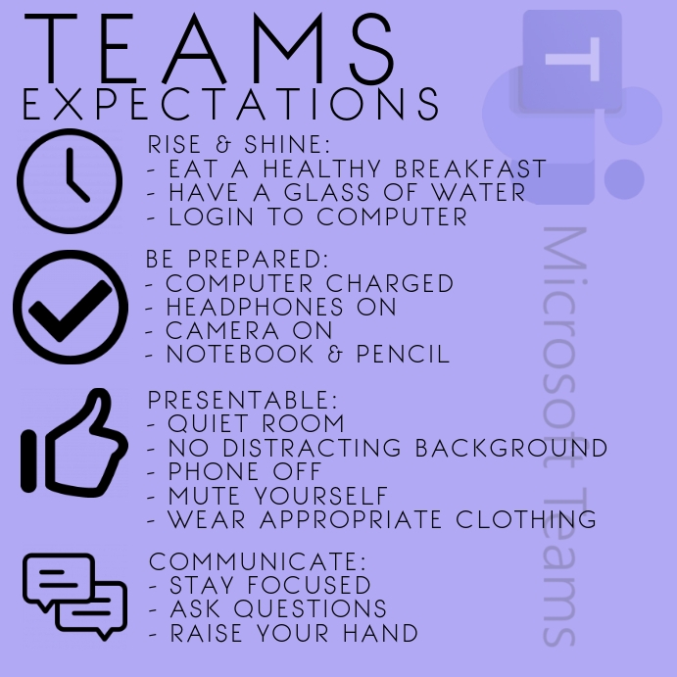

Slide 5
8th Grade English
The 8th grade English Language Arts curriculum uses various genres to focus on the theme of self-discovery within societal and family units.
Utilizing literature, students will be able to produce various critical, analytical and creative products. Students will also be accountable for the management of their reading and writing workshop and portfolios, organizers, class notes and self-monitored progress.
Reading, writing and research skills are integrated throughout the curriculum to prepare students for the rigors and demands of the 9th grade English curriculum.
The main focus of our literature study will be on the following topics:
How do I fit into my society?
Why are individuals and individuality important to society?

Slide 6
8th Grade English Grading Policy
tests, essays, projects
homework
classwork/quizzes
participation (discussion and Nearpods)
(total points; not weighted categories)
**Homework is not assigned every night; Any homework assignments assigned are necessary to either reinforce class work or prepare students for an upcoming topic.**

Slide 7
Literary Works
Author Study: Edgar Allan Poe
“Flowers for Algernon” by Daniel Keyes
Short Stories
Poetry
“A Midsummer Night’s Dream” Shakespeare
Various selections, and current event articles used for supplemental integration amongst units.

Slide 8
Writing Workshop
Writing genre is introduced through a modeled text and/or reading.
Through mini-lessons students are then taught writing skills that they will need in order to complete a Writing Workshop piece.
Students will then engage in the writing process utilizing their own timing and differentiated resources. Most, if not all, writing will occur in the classroom.
Mini-conferences between teacher and student and peer conferencing will be held throughout the duration of the Writing Workshop providing students with opportunities to “check-in” in regards to their writing.
I will grade each piece using a task specific rubric. The rubric will utilize criteria that was taught through the mini-lesson.
If I return a paper and a grade is less than a 90% the student is encouraged to revise, correct and improve their work.

Slide 9
8th Grade Social Studies Curriculum and Skills
Civil War → Present time
Students will practice critical evaluation of texts and synthesizing information amongst sources.
Analyze the relationship between primary and secondary sources of the same topic through annotating and close reading practices.
Evaluate author’s purpose, reasoning and use of evidence.

Slide 10
8th Grade Social Studies Curriculum and Skills
Prepare and participate in a range of discussions and collaborations to build upon others’ ideas and expressing their own clearly and persuasively.
Specific reading, writing and research strategies are the focus in each lesson to prepare your child for high school.

Slide 11
8th Grade Social Studies Grading
Grading is determined through a total point system.
Homework - 10-20 points
Classwork- 10-20 points
Quizzes-5-30 points
Nearpod Participation-2-5 points
*Homework is either review of the daily lesson or practice for an upcoming topic.

Slide 12
Reading and Writing Expectations Across the Curriculum
Annotating based on genre (fiction vs. nonfiction).
Critical evaluation of texts and synthesizing information amongst sources.
Analyzing for presence and use of literary devices, sequencing, author’s purpose and point of view, and development of ideas.

Slide 13
Reading and Writing Across the Curriculum
Distinguish among fact, opinion and reasoned judgment in a text
Writing cohesive TSC paragraphs that address a prompt or question with relevant, text-based evidence.
Planning and writing extended responses (essays) based on a common Written Response Rubric. Extended responses should prove a thesis and be fully-developed with text based evidence used in support of a claim.

Slide 14
Technology: Communication and Instruction
Microsoft Teams (the app works best!) – interactive platform that allows for teachers to directly instruct, collaborate and provide class materials and assignments to students.
Students will submit most of their work in their Assignments sections or in their Class Notebooks on Teams.
Teachers will use the General Posts section to provide daily instructional agendas and objectives.
Students can use the Chat feature to privately message their teachers regarding any issues they may have.
Remind – Parent, teacher and student app that allows for teachers to alert parents and students of upcoming assignments and events. Each class has their own section to join by code.
Microsoft 365 Outlook – student, teacher and administrator emails.

Slide 15
8th Grade Remind App Codes:
Please download the Remind app and use the codes to stay in contact:
@mflaherty8 — English
@jpiccoli8 -- math
@622hg8 -- science
@bf9c96 -- social studies
@bcozzalih8 – health
@kellerpe8 – physical education

Slide 16
Technology: Apps for Content and Assessment
CLEVER – Website where students have a single sign-on to access all of the following apps and resources; students need to know their 6 digit ID number and password to sign in to Clever:
Nearpod – Interactive instructional software that delivers lessons, videos, classwork and assessments.
Quill – A grammar diagnostic app that gives students the opportunity to target and practice areas of writing weakness.
CommonLit – A literacy app in which students are assigned readings where they must answer guided and comprehension questions.
CASTLE – An online web-based instructional service that provides review and content in math, science, English and social studies.
Quizizz – A gamified quiz app that allows students to review and also can give teachers the opportunity to test students’ content knowledge.
BrainPop – An animated educational site for kids that gives students an introduction to content while testing their knowledge of what they have learned.

